Slide 1
POLARIZATION
DR. ARCHANA S. SHARMA

Slide 2
Polarization of Light
Light waves are transverse in nature i. e. the waves propagates in a direction perpendicular to the direction of vibration of particles.
According to Maxwell, light waves are electromagnetic. In an EMW, electric & magnetic field vector vibrate mutually perpendicular & also perpendicular to the direction of propagation of propagation of waves.
Now, according to the theoretical and experienced evidences, it is the electric field vector E which produces all the observed effects of light.
So whenever we talk of vibrations in a light wave, we mean vibrations of the electric vector E.
Light is emitted by excited atoms & molecules. So in a ray of light millions of waves follow each other in rapid succession at random. Hence, the vibrations are possible in all directions.
So an ordinary light beam is unpolarised. In an unpolarised light, the electric vector keeps on changing its direction in a random manner. If electric vector oscillates in a particular direction then light is said to be linearly polarised.

Slide 3
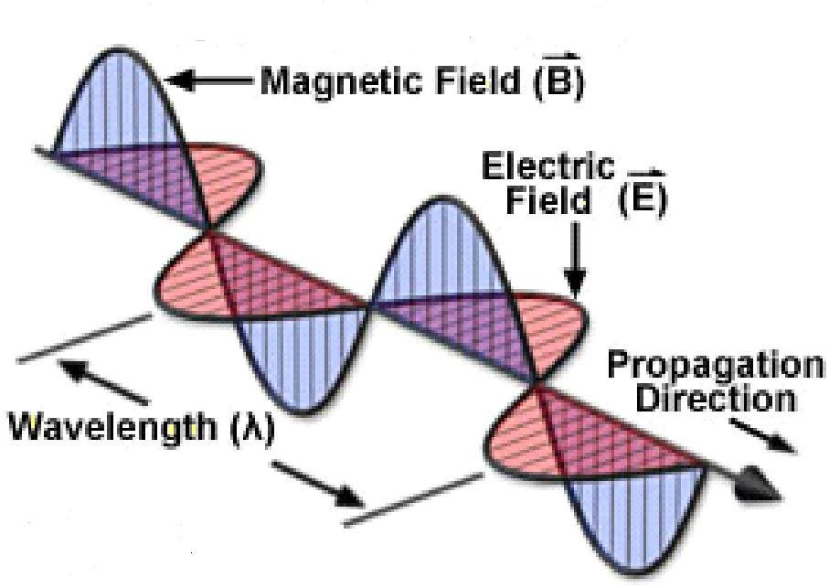
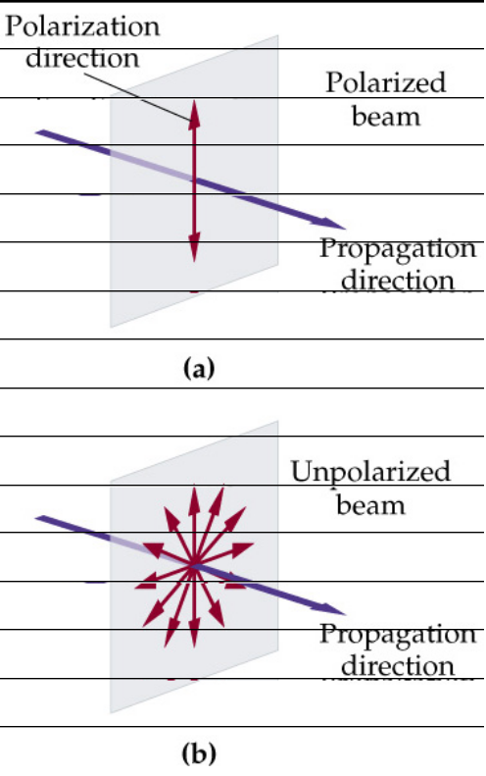
POLARIZED LIGHT
Polarized Light
Vibrations lie on one single plane only.
Unpolarized Light
Superposition of many beams, in the same direction of propagation, but each with random polarization.

Slide 4
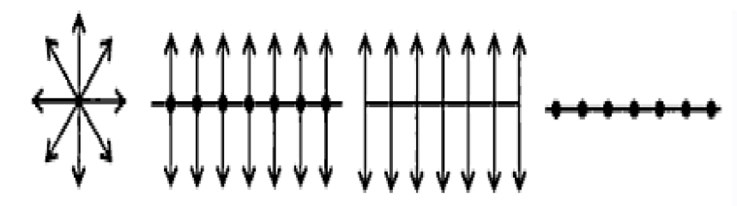
REPRESENTATION OF POLARIZED LIGHT
(a) Ordinary light (b) Unpolarized light (c) Plane Polarized light with vibration along the plane of paper (d) Plane Polarized light with vibration perpendicular the plane of paper.

Slide 5
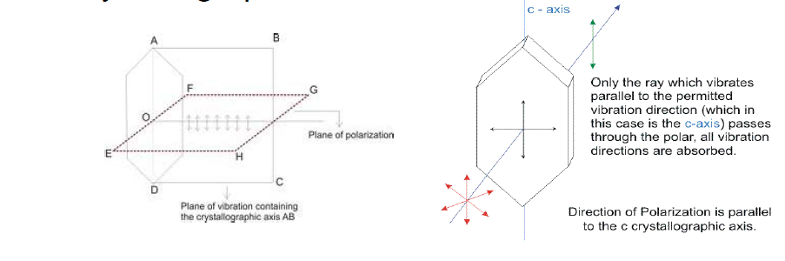
Experimental demonstration of polarization
To demonstrate polarization, we used Tourmaline crystal, which has certain characteristics features. This crystal allow vibrations to pass through which are parallel to its crystallographic axis, & completely stop, which are perpendicular to crystallographic axis.

Slide 6
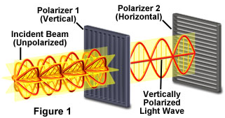
POLARIZATION OF LIGHT

Slide 7
Polarizer and Analyzer

Slide 8
WORKING OF A POLARIZER
An ideal polarizer passes 100% of the incident light that is polarized in the direction of the polarizing axis but completely blocks all light that is polarized perpendicular to this axis.
When Unpolarized light is incident on an ideal polarizer, the intensity of the transmitted light is exactly half that of the incident Unpolarized light, no matter how the polarizing axis is oriented.

Slide 9



INTENSITY OF LIGHT TRANSMITTED THROUGH A POLARIZER
If a beam of plane-polarized light strikes a polarizer whose axis is at an angle of θ to the incident polarization direction, the beam will emerge as a plane-polarized light parallel to the polarizing axis and its amplitude will be reduced by cos θ.
θ
Transmitted
wave
Incident beam of
Amplitude
Vertical
Polaroid

Slide 10
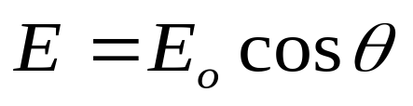
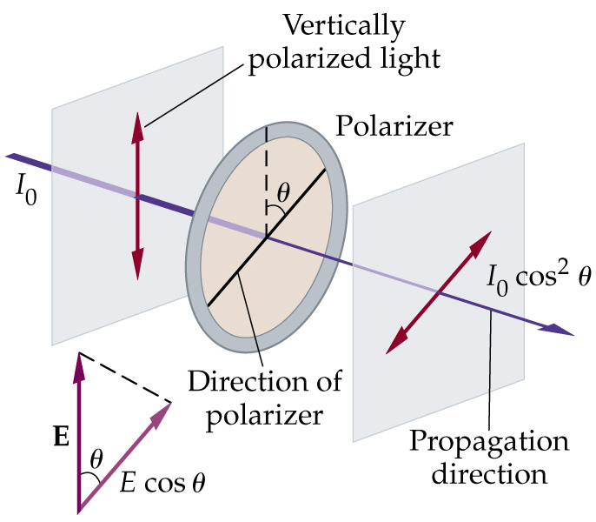
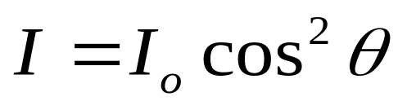
INTENSITY OF LIGHT TRANSMITTED THROUGH A POLARIZER
A Polarizer passes only that component of polarization that is parallel to its axis.
As the intensity of a light beam is proportional to the square of the amplitude, and
Hence the intensity of a plane-polarized beam transmitted by a polarizer is

Slide 11
PRODUCTION OF PLANE
POLARIZED LIGHT

Slide 12
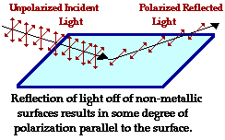
POLARIZATION BY REFLECTION
Unpolarized light can be polarized, either partially or completely, by reflection.
The amount of polarization in the reflected beam depends on the angle of incidence.

Slide 13
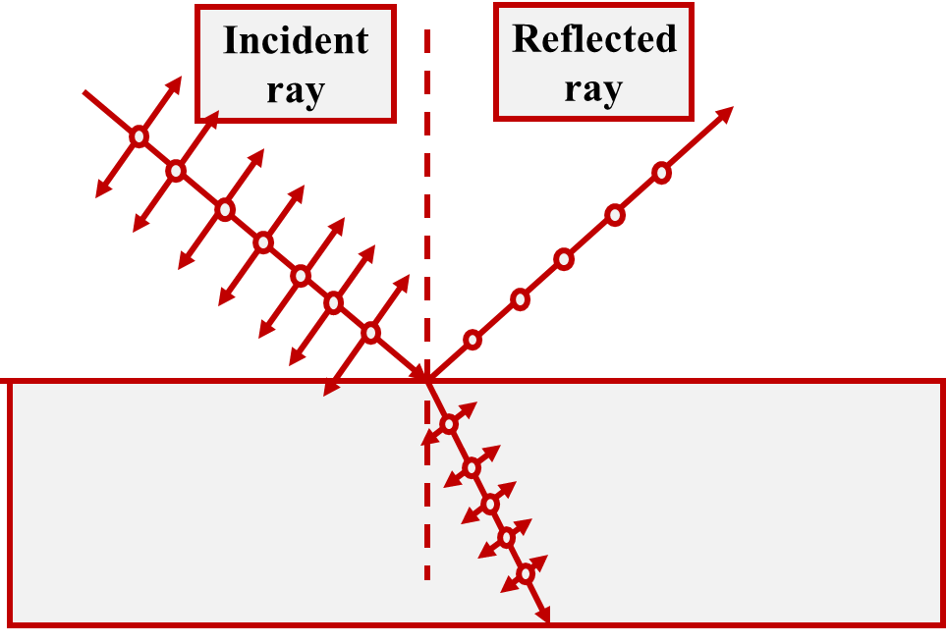
BREWSTER’S LAW
It is found that experimentally when the reflected ray is perpendicular to the refracted ray, the reflected light will be completely plane-polarized.
i
90֯
n₁
r
n₂

Slide 14
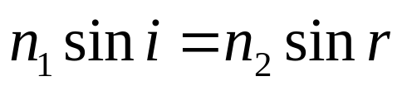
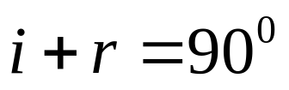
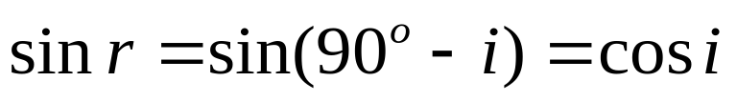
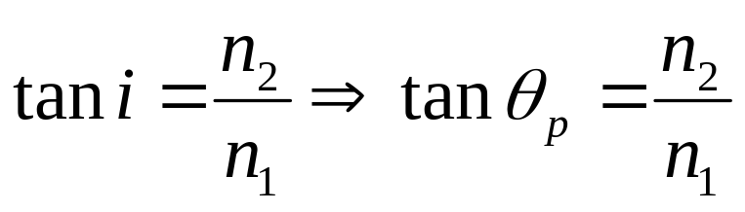
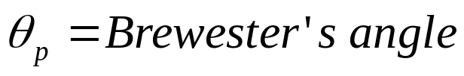
POLARIZING ANGLE (BREWSTER’S ANGLE)
The angle of incidence at which the reflected light is completely plane-polarized is called the polarizing angle (or Brewster’s angle).
Maximum polarization occurs when i+ r = 90֯
By Snell’s law,
Since
and
Then we get,
,

Slide 15
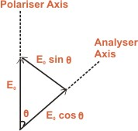
MALUS’S LAW
When completely plane polarized light is incident on the analyzer, the intensity I of the light transmitted by the analyzer is directly proportional to the square of the cosine of angle between the transmission axes of the analyzer and the polarizer.
θ : Angle between the transmission axes of the the polarizer and analyzer.
The completely plane polarized light from the polarizer is incident on the analyzer.
If E₀ is the amplitude of the electric vector transmitted by the polarizer, then intensity I₀ of the light incident on the analyzer is
I₀ α E₀²

Slide 16
E₀ can be resolved into two rectangular components i.e E₀ cos θ and E₀ sin θ. E₀ cos θ is allowed. The component E₀ sin θ is absorbed by the analyser. Therefore, the intensity I of light transmitted by the analyzer is given as
I ∞ ( E₀ cosθ )²
I / I₀ = ( E₀ cosθ )² / E₀² = cos²θ
I = I₀ cos²θ
Therefore, I ∞ cos²θ. This proves Malus’s law.
When θ = 0° ( or 180° ), I = I₀ cos²0° = I₀ .That is the intensity of light transmitted by the analyzer is maximum when the transmission axes of the analyzer and the polarizer are parallel.
When θ = 90°, I = I₀ cos²90° = 0. That is the intensity of light transmitted by the analyzer is minimum when the transmission axes of the analyzer and polarizer are perpendicular to each other.

Slide 17
DOUBLE REFRACTION
Some crystals in nature have different index of refraction in different directions.
The index of refraction depends on the direction of polarization of the light entering the crystal.
Since the index of refraction determines the speed of light in the medium (c/n), thus different indexes of refraction for different polarizations creates phase difference between different polarization. Thus, the material split the light incident on it into two separate polarized beams, at right angle to each other.
The two beams are called:
Ordinary Beam - A beam that pass through the material in a path determined by Snell’s law of refraction.
Extraordinary Beam - does not oblige to Snell law, and have a deviation to the side.

Slide 18
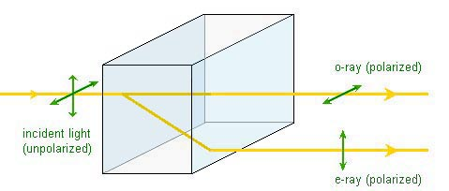
Practically, the material have different indexes of refraction for the ordinary beam and the extraordinary beam. Such material is said to have Birefringence (Double Refraction).
Two types of doubly refracting crystals:
Uniaxial: There is only one direction (optic axis) along which the two refracted rays travel with the same velocity. Eg. Tourmaline, calcite and quartz crystal.
Biaxial: There are two such directions along which the velocities are same. Eg. Topaz, Aragonite.

Slide 19
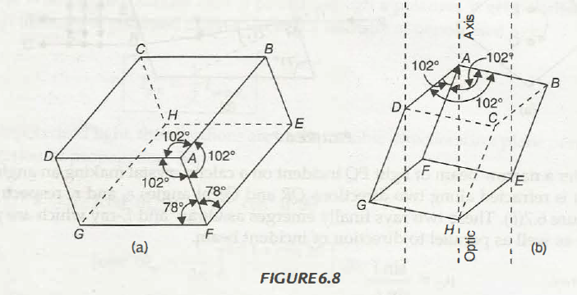
Calcite Crystal
A calcite crystal(CaCO₃) has rhombohedron structure. Hence, it breaks into the blocks of with parallelogram shaped faces. It is bounded by six faces, each of which is a parallelogram, with angles 78° & 102° nearly (blunt corners). It has only two diametrically opposite corners where all face angles are obtuse (102 °). At the rest of the six corners there is one obtuse angle and two acute angles.

Slide 20
Optic axis and Principal axis
Optic Axis: The direction of optic axis is a line passing through any one of the blunt corners and equally inclined to the three edges meeting there. Along optic axis, there is no double refraction as the structure is symmetric in that direction.
Principal Section: A plane containing the optic axis and perpendicular to a pair of opposite faces of the crystal is called principal section of the crystal for that pair of faces. A principal section, always cuts the surfaces of the calcite crystal in a parallelogram having angles 71° & 109°.

Slide 21

NICOL PRISM
It is an optical device made from calcite crystal and is used in many optical instrument for producing and analyzing plane polarized light. It is constructed in such a way that the O-ray get totally reflected and E-ray get transmitted. It gives an instance beam of plane polarized light.
Principle: It depends on the phenomenon of double refraction. i.e. ordinary and extra ordinary rays in calcite possess unequal refractive index.
Construction:

Slide 22
In a Nicol prism, we want total internal reflection of ordinary ray and transmission of Extraordinary ray at calcite – Canada balsam interface.
The refractive index of calcite
for O – Ray is μ_{o} = 1.658
for E – ray is μ_{E} = 1.486
& μ_{CB} = 1.55
Canada balsam is optically rarer for O – ray and optically denser for E – ray. The critical angle can be calculated as
θ_{c} = sin ⁻¹ (1.55/1.658) = 69.20°
when angle of incidence at calcite- Canada balsam interface become greater than critical angle, then the conditions of total total internal reflection are satisfied , the O-ray get totally reflected. The E – ray get transmitted.
Limitation: Nicol prism can not be used for highly convergent and highly divergent beams. The angular limit is 14° on either side (28° in total in both sides between the extreme rays).

Slide 23
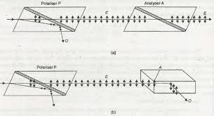
Uses of Nicol Prism
Nicol prism can be used as a Polarizer and as an Analyzer.

Slide 24
TYPES OF POLARIZED LIGHT

Slide 25
Elliptically and circularly Polarized Light
When Linearly polarized monochromatic light is incident at an angle on a doubly refracting crystal with optic axis parallel to refracting face, it splits up in to Ordinary and Extra-ordinary components. The two components travel in same direction with different velocities. On emergence. depending on the thickness of the crystal and angle of incidence, light may be elliptically or circularly or plane polarized as explained below.

Slide 26
Theory
Let A = amplitude of the incident plane polarized light of wavelength λ
θ = angle made by linear vibrations with optic axes.
The component of A in x- direction = A cos θ and in y- direction = A sin θ
On emerging from the crystal they have a phase difference δ.
So the equation for the two waves vibrating along perpendicular directions and having a phase difference δ.
For E-rays
x = A cos θ sin (ωt + δ) --------- (1) [ let A cos θ = a]
Therefore, x = a sin (ωt + δ)
For O-rays
y = A sin θ sin (ωt) --------- (2) [A sin θ = b]
y = b sin (ωt)
On solving equation 1 & 2
x²/a² + y²/b² – 2xy/(ab) cos δ = sin²δ -------(3)

Slide 27
Special cases:
(i) If δ = 0 or 2nπ then sin δ = 0, cos δ=1. Eq. (3) gives y = (b/a)x
It is an equation of straight line with slope b/a. So the emergent light is plane polarized.
(ii) If δ = (2n + 1) π/2 then Equation (3) gives x²/a² + y²/b²=1
This represents the equation of an ellipse. The emergent light will be elliptically polarized. The magnitude of electric field vector E changes with time and vector E rotates about the direction of propagation and sweeps a flattened helix in space.
(iii) If δ = π/2 then Eq. (3) gives x² + y² = 1
It is an equation of a circle. So the emergent light is circularly Polarized. During the course of wave propagation, the magnitude of the electric field vector E stays constant and also rotates at a constant rate about the direction of propagation and sweeps a circular helix in space.

Slide 28
